Slide 1
CAREER INFORMATION AND RECRUITMENT PORTAL
Project Guide: Ms. Sruthimol M P
Lecturer
Department of Information Technology
Group Members:
Jincy P Janardhanan (IEAREIT017)
Aleena Sunny (IEAREIT006)
Alka Bhagavaldas K (IEAREIT007)
Ameena Shirin (IEAREIT009)

Slide 2
CONTENTS
Problem Statement
Motivation
Objectives
System Study
Requirements Gathering and Analysis
SRS Document
Design
Implementation
Testing
Future Perspectives
Conclusion
References

Slide 3
PROBLEM STATEMENT
Students can’t find the right job.
Recruiters can’t access student details.
Important functions may be missed.
Students miss recruiter updates.
No effective placement cell management.

Slide 4
MOTIVATION
Provide a user-friendly recruitment portal platform.
Ease the work of staffs.
Provide medium to choose best companies and employees.
Provide categorized and suitable jobs.
Increase knowledge about job resources.

Slide 5
OBJECTIVES
Developing a web application for career information and recruitment.
Connect students, colleges, recruiters and alumni.
Ease of job application.
Easily maintain job information and applications.
Easily review CV of student or alumni.
Recruiters can easily maintain job details.

Slide 6
SYSTEM STUDY
EXISTING SYSTEM
PROPOSED METHODOLOGY
Manually maintained
Time consuming
Difficult to updating data
Errors can occur
Data storing is difficult
A secure and easy-to-use web application in Java using Spring boot and Spring security frameworks
Placement cell management for colleges
Student or alumni hiring for recruiters
Job finding opportunity for student and alumni
FEASIBILITY STUDY
Feasible on a system with basic requirements
Technical feasibility: easy to use
Easy to maintain the operation
Schedule and maintenance is easier
Low budget

Slide 7
REQUIREMENTS GATHERING AND ANALYSIS
END-USER REQUIREMENTS
HARDWARE REQUIREMENTS
SOFTWARE REQUIREMENTS
PC with basic requirements
Stable network connection
4 GHz minimum, multi-core processor
RAM: Minimum 2 GB
Hard disk space: Minimum 10 GB
Operating System:
Windows 7+
Mac OS X Yosemite 10.10+
Linux: 64-bit Ubuntu 14.04+, Debian 8+, openSUSE 13.3+ or Fedora Linux 24+
Front end: Thymeleaf
Back end: Spring boot, Spring security and MongoDB
Web server: Embedded Tomcat
Supported browsers: Chrome, Firefox, Internet Explorer 9+
Java 1.8+

Slide 8
SRS DOCUMENT
Software Requirements Specification (SRS), documents all expected functionalities of a system/application by the end user.
Our SRS Document for this project can be found from here.

Slide 9
DESIGN
The various packages used in this project are as follows:
App
Config – general package for configuration purposes
Security – specialized package for web security
Controllers – to control data flow and various views of the application
Model – POJO classes to represent the data model for the application
Repository – DAO layer for various database operations
Service – to handle business logic of various operations
Security – to handle security related business logic operations
Resources – Holds the different resources associated with the application (HTML pages, CSS styling and images)
Test – for testing the application features implemented via the above packages
JRE System Libraries – default and essential to include various Java libraries
Maven dependencies – default and essential to include various Maven dependencies

Slide 10
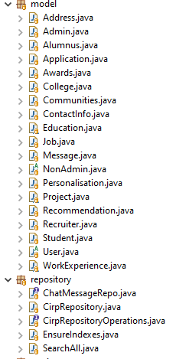
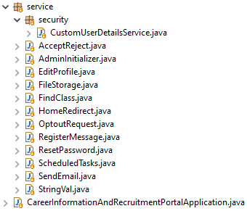
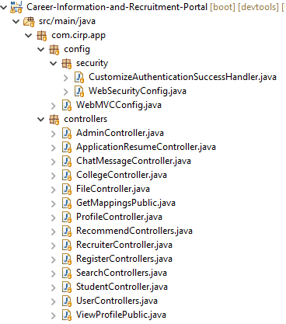
PACKAGE STRUCTURE

Slide 11
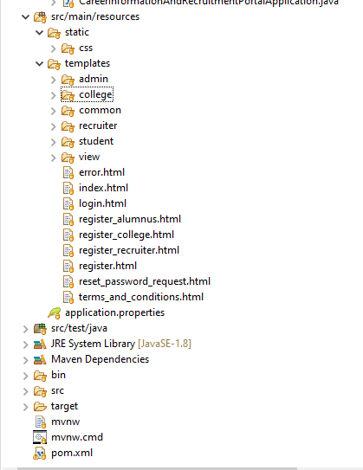
PACKAGE STRUCTURE
(Contd.)

Slide 12
DATA FLOW DIAGRAMS

Slide 13
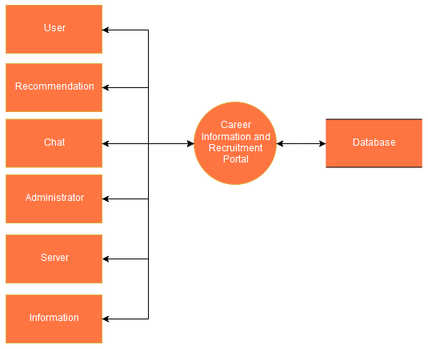
LEVEL 0
Level 0. Context Diagram for Career Information and Recruitment portal.

Slide 14
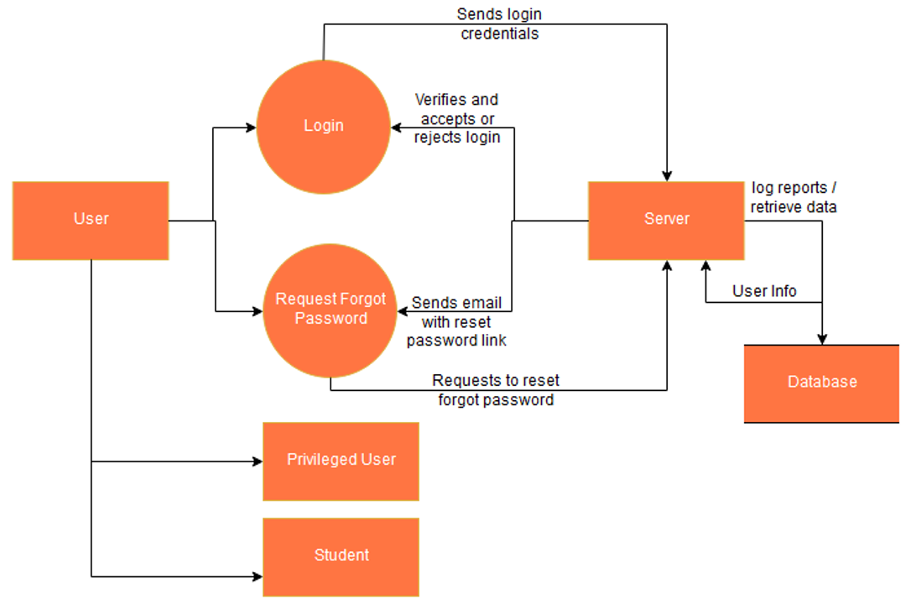
LEVEL 1 DIAGRAMS
Level 1.1 User module - implemented as class

Slide 15
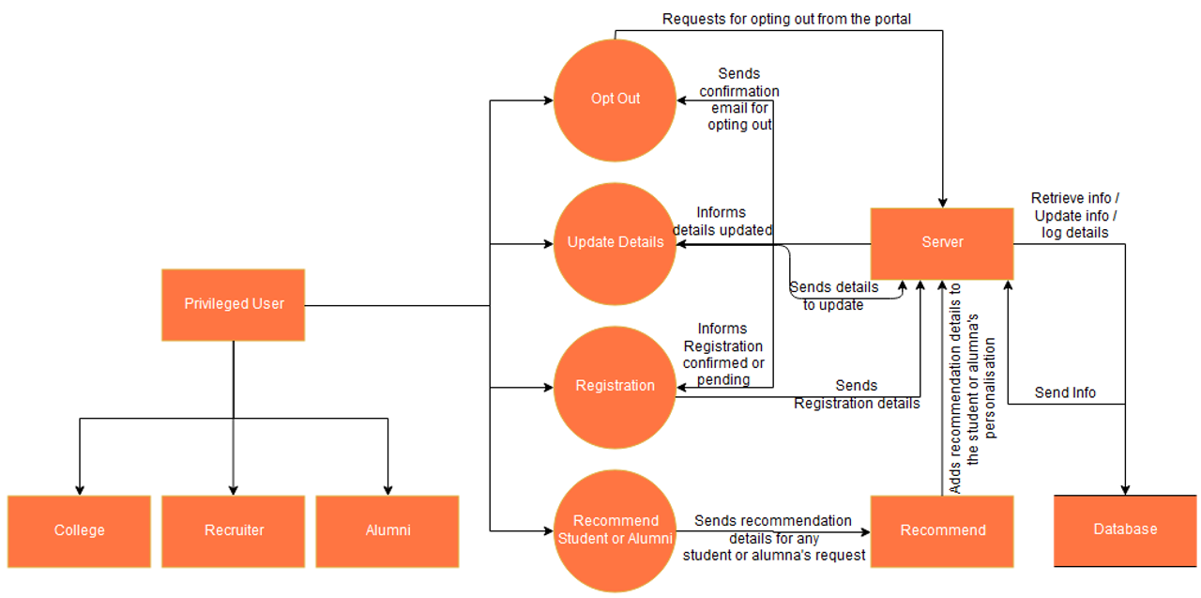
Level 1.1.1 - Privileged User (sub-module of User (1.1), implemented via interfaces only)

Slide 16
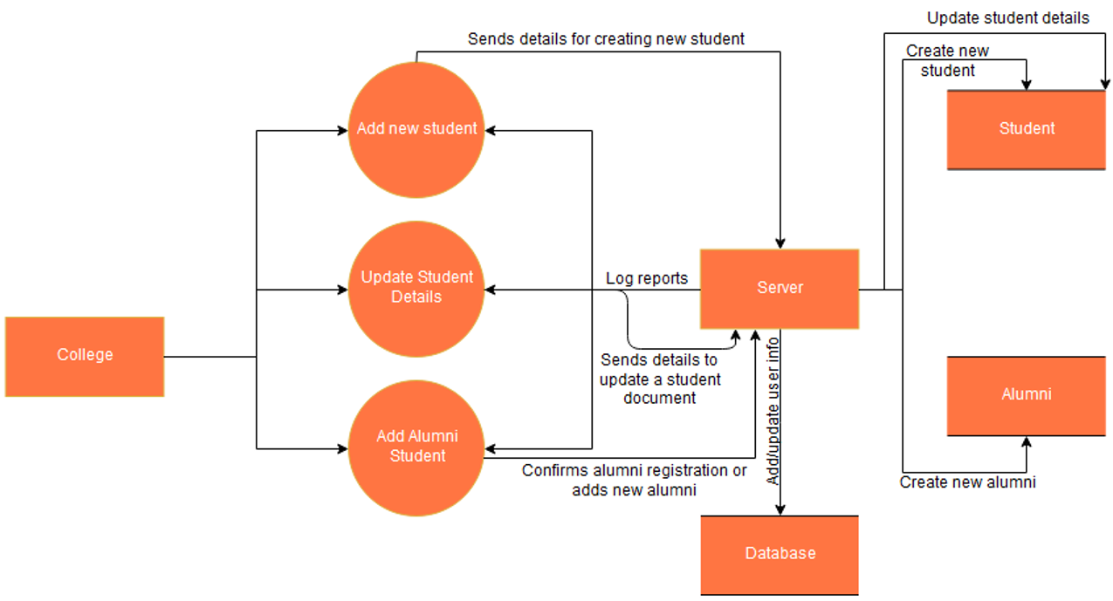
Level 1.1.1.1 - College module (implements Privileged User interface, implemented as class)

Slide 17
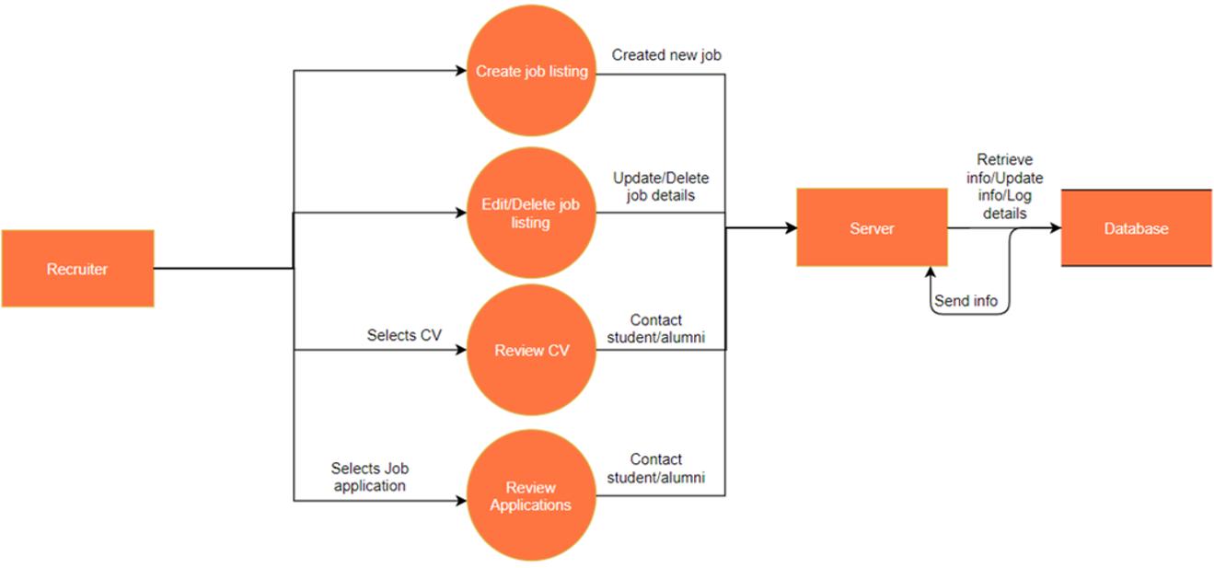
Level 1.1.1.2 - Recruiter module (implements Privileged User interface, implemented as class)

Slide 18
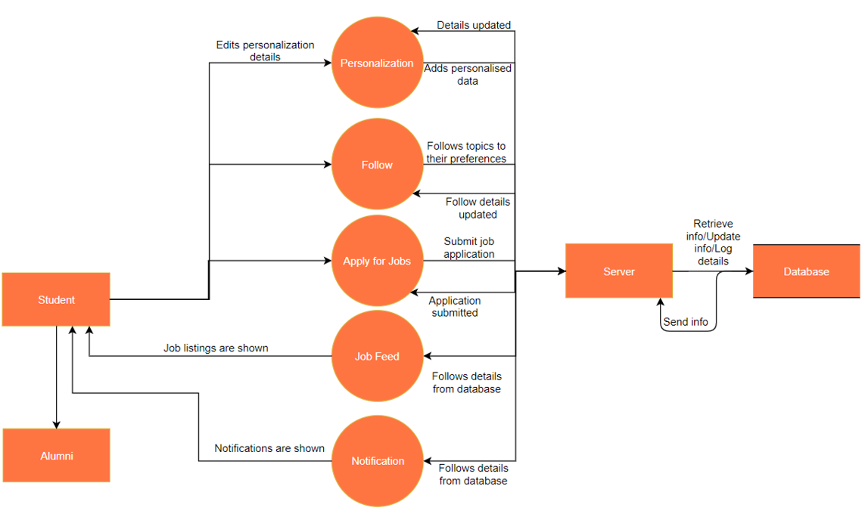
Level 1.1.2 - Student (Sub-module of User (1.1), implemented as class)

Slide 19
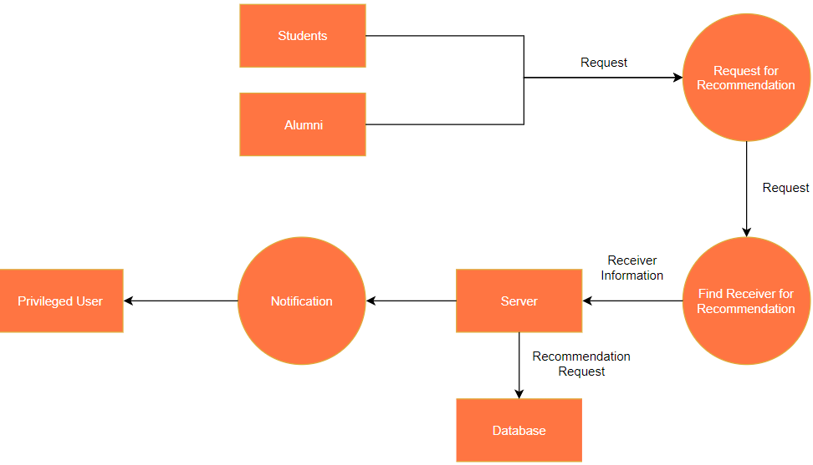
Level 1.2.1 - Request Recommendation (Recommendation module (1.2) has two functions - Request Recommendation and Recommend, both are implemented via separate interfaces and hence considered as sub-modules.)

Slide 20
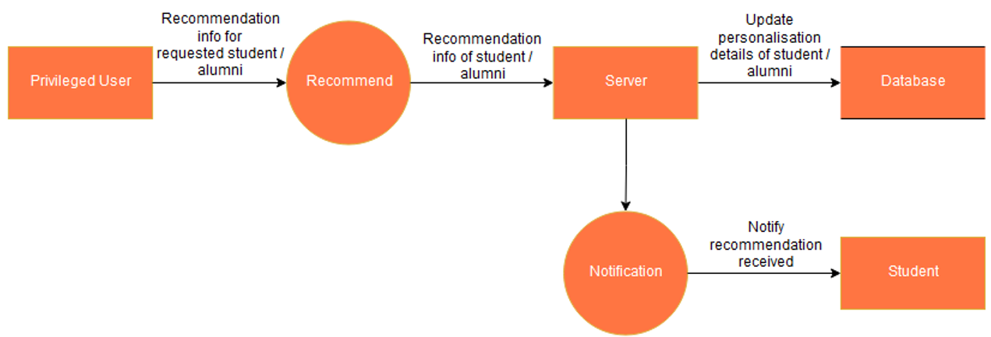
Level 1.2.2 - Recommend (Recommendation module (1.2) has two functions - Request Recommendation and Recommend, both are implemented via separate interfaces and hence considered as sub-modules.)

Slide 21
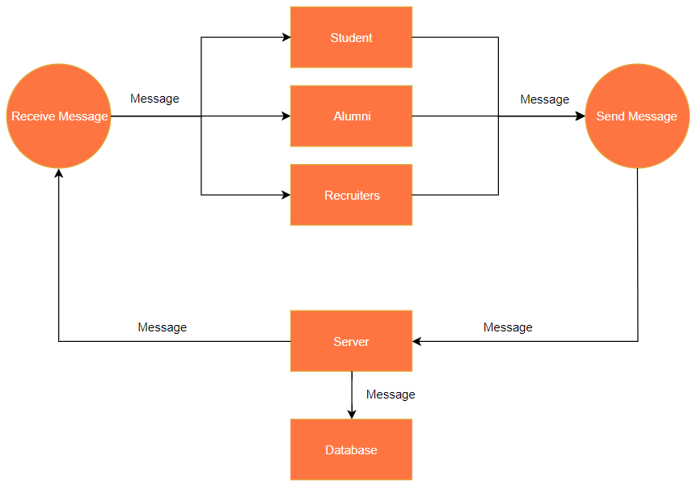
Level 1.3 - Chat (Implemented via interfaces only, implemented by Recruiter and Student classes)

Slide 22
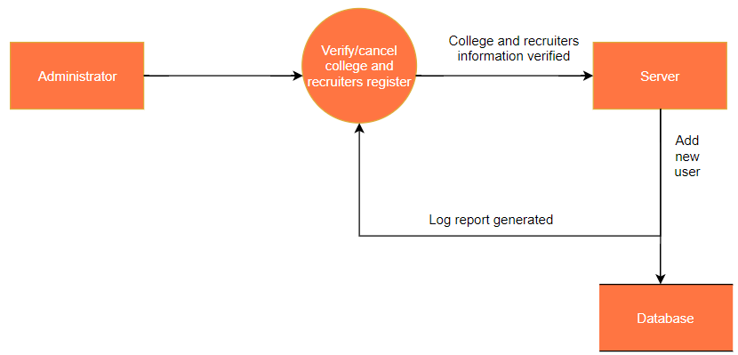
Level 1.4 - Administrator module (Implemented as class)

Slide 23
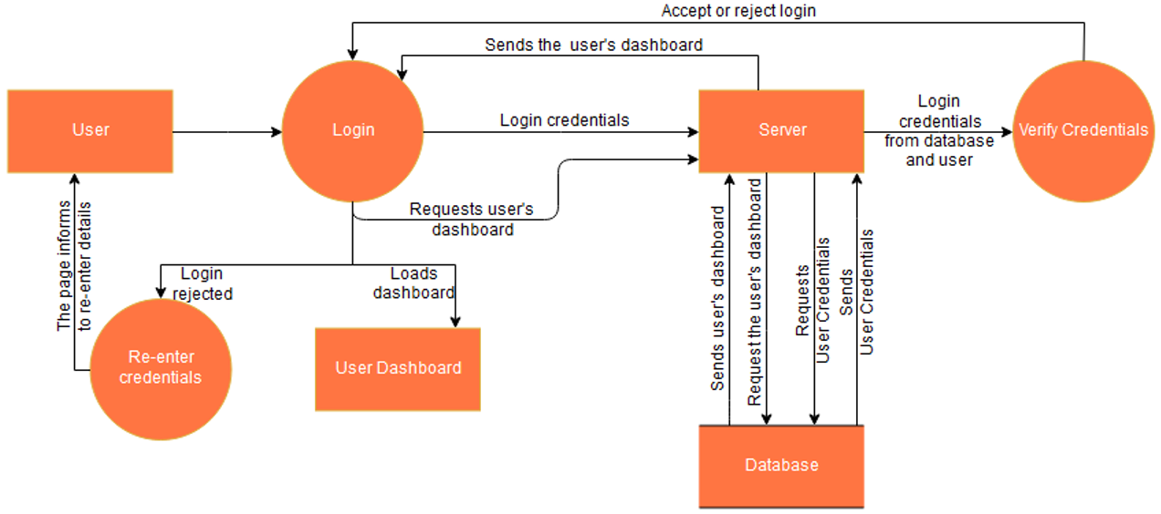
LEVEL 2 DIAGRAMS
Level 2.1 - User login

Slide 24
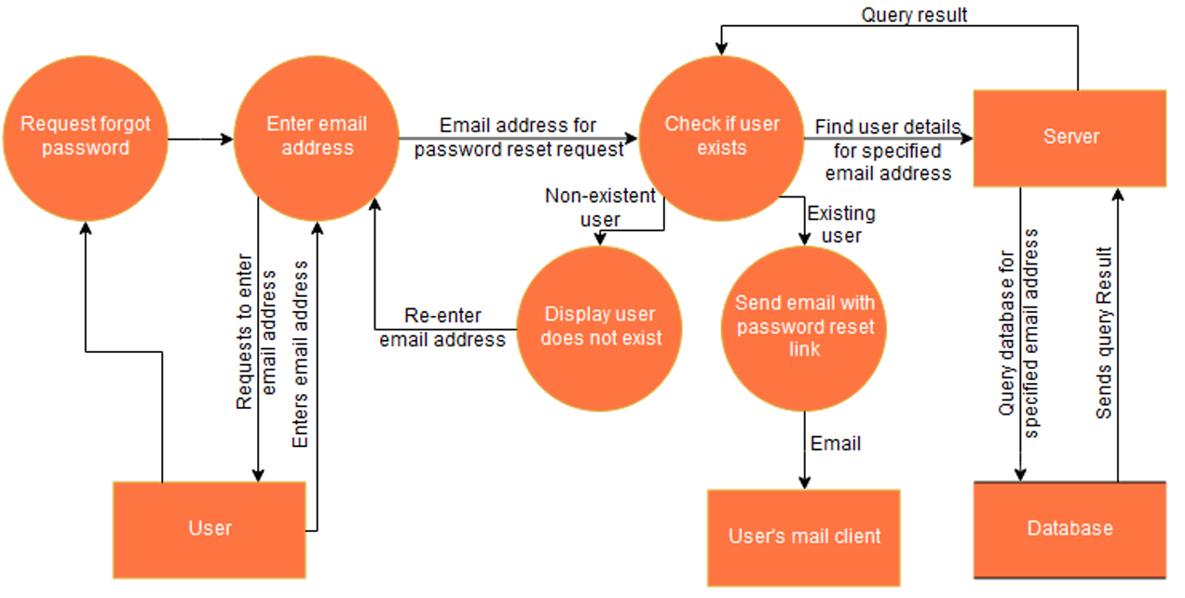
Level 2.2 - Request for forgot password

Slide 25
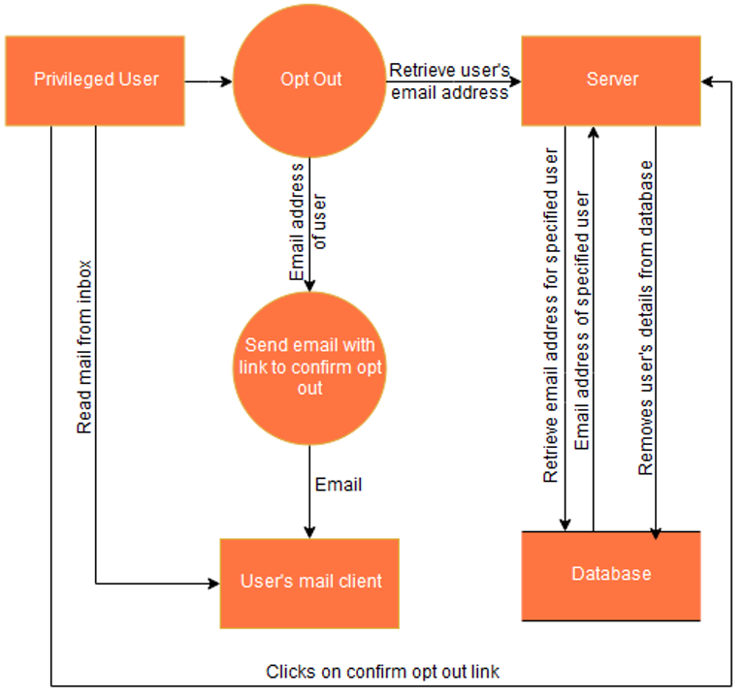
Level 2.3 - Opt out request by any privileged user

Slide 26
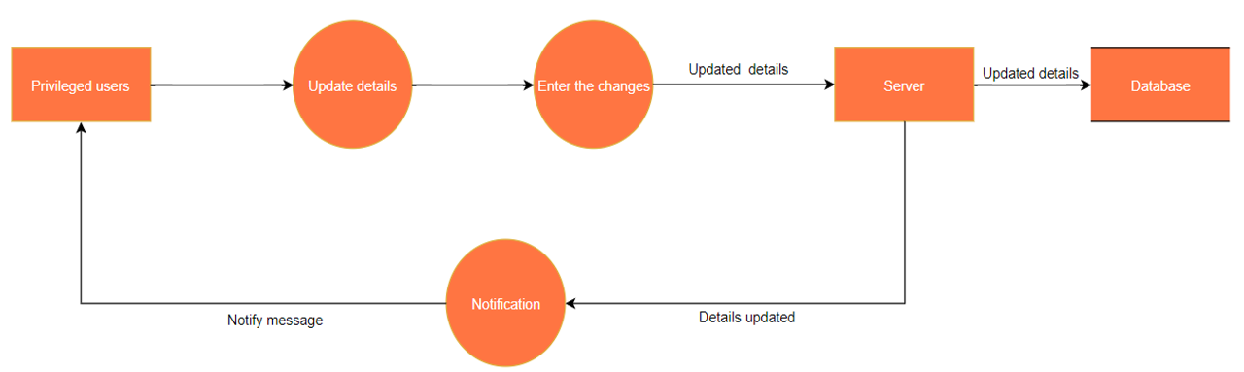
Level 2.4 - Update details of any privileged user

Slide 27
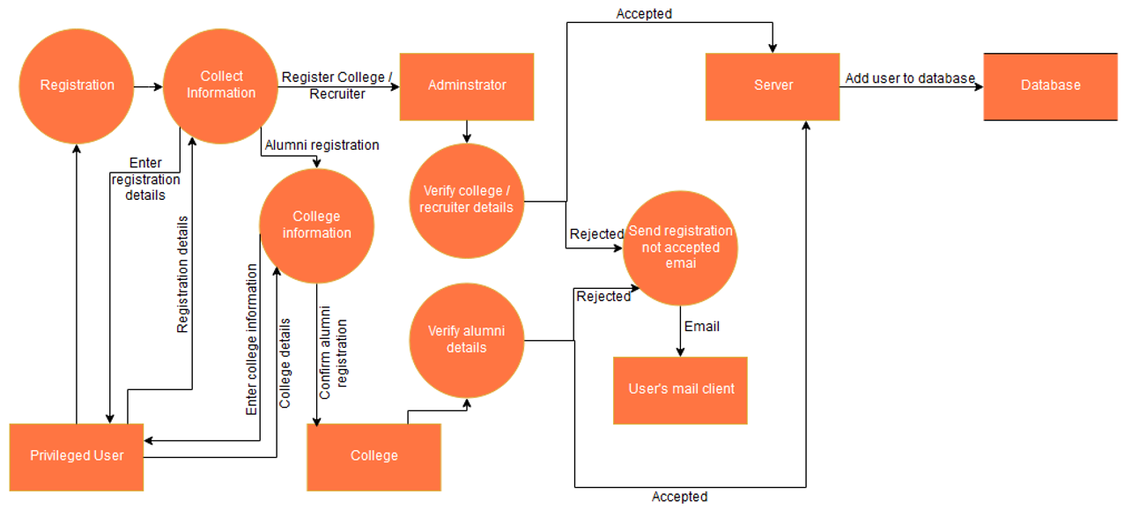
Level 2.5 - Registration of any privileged user

Slide 28
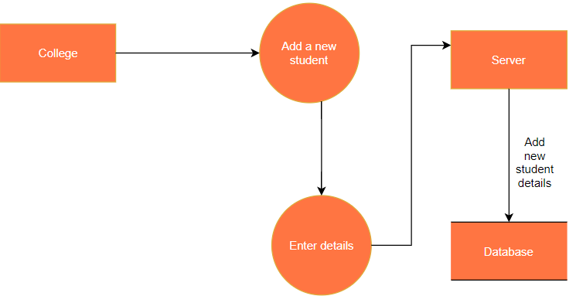
Level 2.6 - Add new student by college

Slide 29
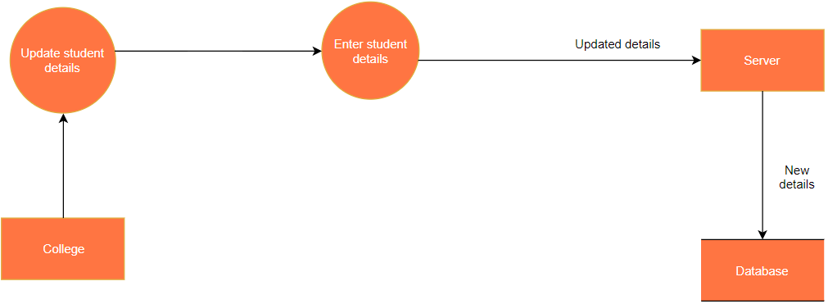
Level 2.7 - Update student details by college

Slide 30
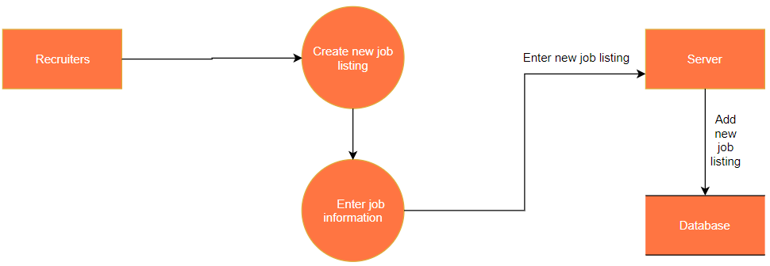
Level 2.8 - Create new job listing by Recruiter

Slide 31
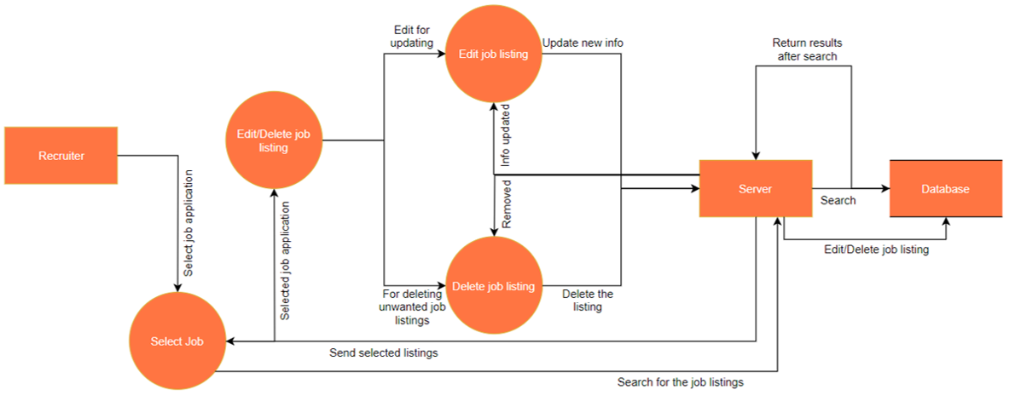
Level 2.9 - Edit or delete job listing by recruiter

Slide 32
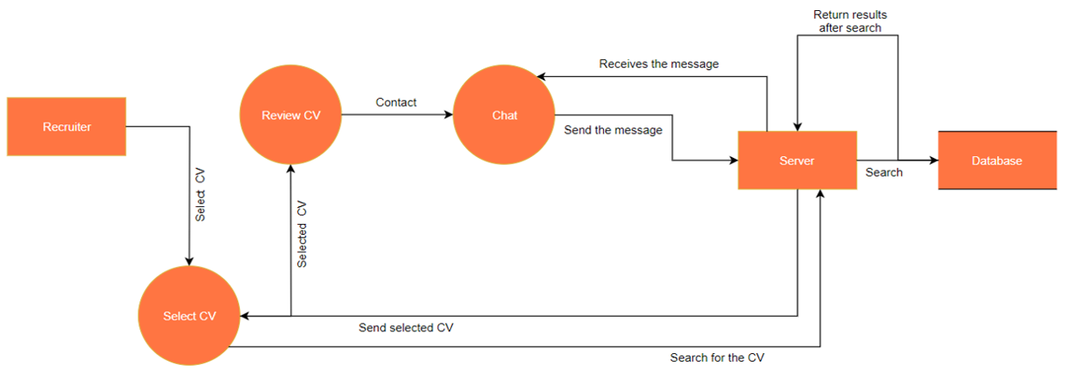
Level 2.10 - Review CV by Recruiter

Slide 33
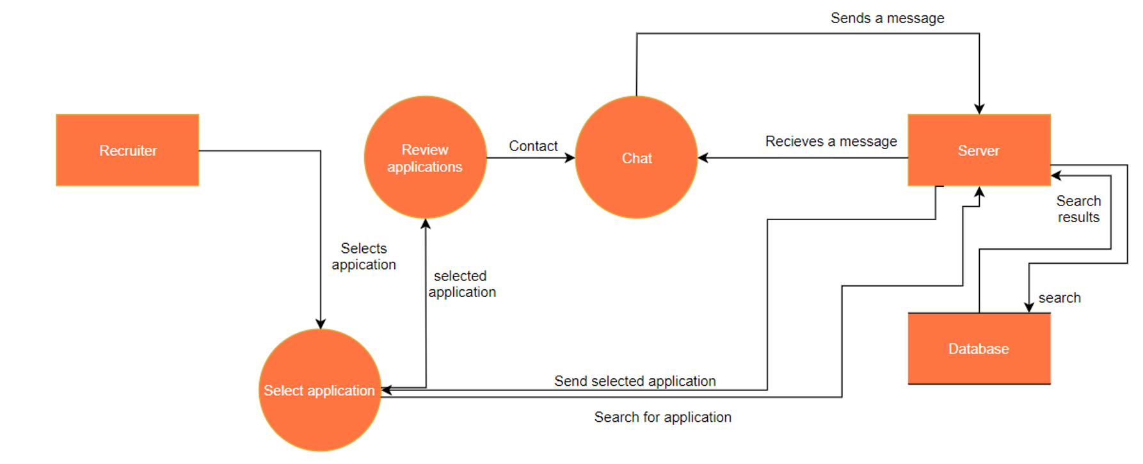
Level 2.11 - Review applications by recruiter

Slide 34
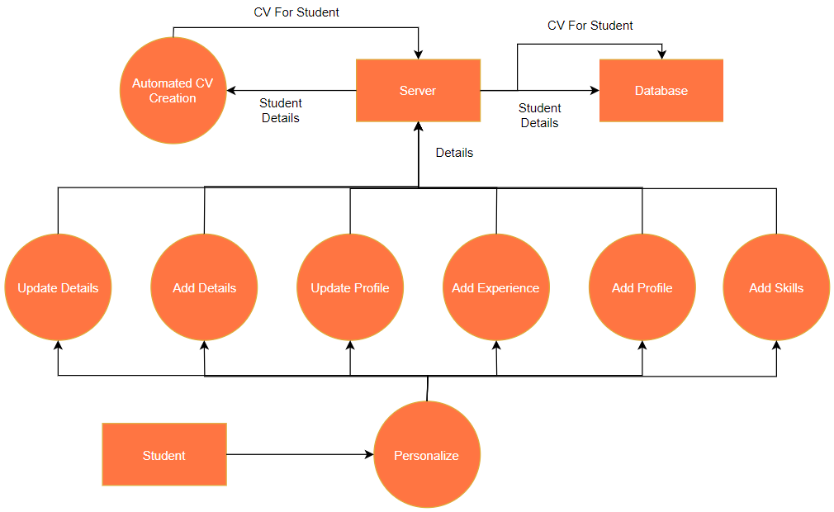
Level 2.12 - Entering personalization details by student

Slide 35
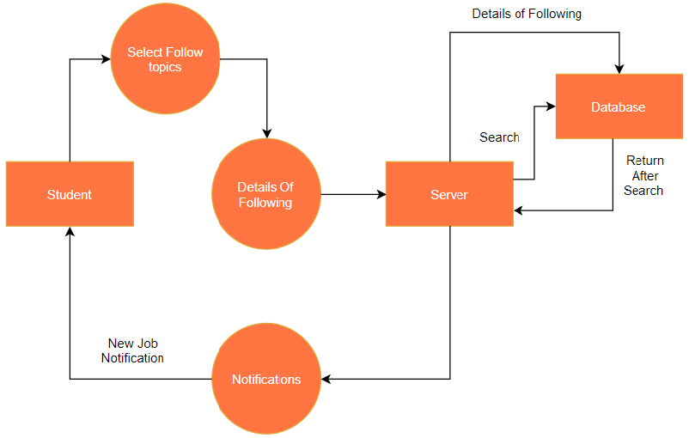
Level 2.13 - Following topics or recruiters by student

Slide 36
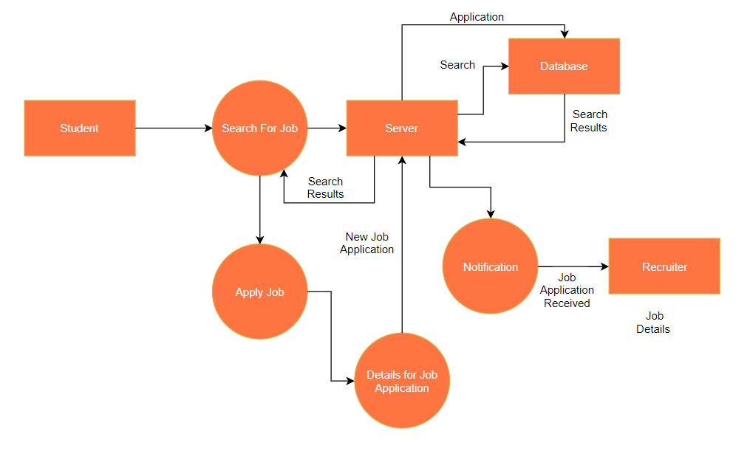
Level 2.14 - Apply for job by student

Slide 37
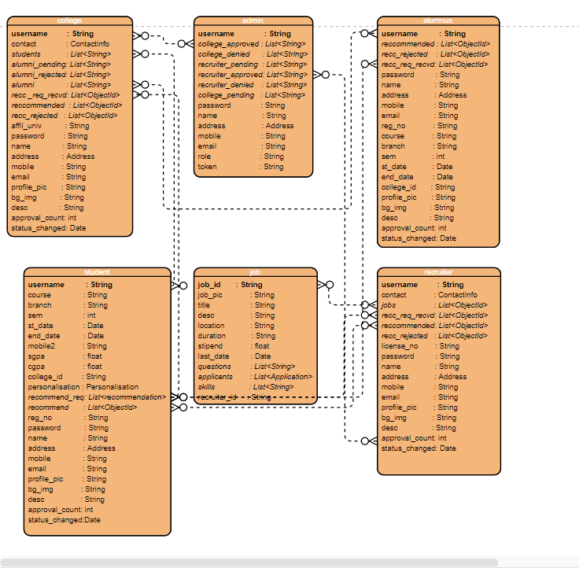

CAREER INFORMATION AND RECRUITMENT PORTAL
DATA
MODELLING
DEPARTMENT OF INFORMATION AND TECHNOLOGY

Slide 38
IMPLEMENTATION
Here we try to provide an overview of the application development involved using sample codes and application screenshots.
DATABASE CONNECTION
VIEW RESOLUTION
EMAIL
spring.data.mongodb.host=localhost
spring.data.mongodb.port=27017
spring.data.mongodb.database=cirp
public void addViewControllers(
ViewControllerRegistry registry) {
registry.addViewController("/home")
.setViewName("index"); registry.addViewController("/")
.setViewName("index"); registry.addViewController("/index")
.setViewName("index"); registry.addViewController("/register").setViewName("register");
registry.addViewController(
"/register-college")
.setViewName("register_college");
/* etc. additional code omitted */
}
@Autowired
JavaMailSender send_email;
public void sendEmail(String to, String sub, String content) {
try {
MimeMessage msg = send_email
.createMimeMessage();
msg.setRecipient( Message.RecipientType.TO,
new InternetAddress(to));
msg.setSubject(sub);
msg.setContent(content, "text/html");
send_email.send(msg);
}
catch (MessagingException e) {
e.printStackTrace();
}
}
SESSION CONTROL
server.servlet.session.timeout = 20m
server.servlet.session.cookie.http-only = true
server.servlet.session.cookie.secure = true
server.error.whitelabel.enabled = false

Slide 39
SECURITY
SERVICE
REPOSITORY
protected void configure(HttpSecurity http) throws Exception {
http.authorizeRequests().antMatchers("/", "/index", "/home", "/register", "/register-recruiter", /register-college", "/register-alumnus", "/terms-and-conditions", "/error", "/login").permitAll()
.antMatchers("/admin-panel").hasRole("ADMIN")
.antMatchers("/college-home", "/college-admin-panel").hasRole("COLLEGE")
.antMatchers("/recruiter-home", "/create-job", "manage-job", "job-applications").hasRole("RECRUITER")
.antMatchers("/student-home").hasRole("STUDENT")
.antMatchers("/alumnus-home").hasRole("ALUMNUS")
.anyRequest().authenticated()
.and()
.formLogin().successHandler(customizeAuthenticationSuccessHandler).loginPage("/login")
.failureUrl("/login?error=true").and()
.httpBasic();
}
// Sample code from services package
public void resetPassword(String username, String new_password) {
Class<?> user_class = find.findClass(username);
repo.updatePassword(username, passwordEncoder.encode(new_password), user_class);
repo.setToken("", username, user_class);
}
@Scheduled(cron = "0 0 12 * * ?") // Scheduled to run at 12 PM everyday
public void deleteRejectedRegistrations() {
Calendar calender = Calendar.getInstance();
calender.setTime(new Date());
calender.add(Calendar.DATE, -14);
cirpRepository.deleteRejectedRegistrations(calender.getTime());
}
// Sample code from repository
public void updateContact(ContactInfo contact, String username, Class<?> user_class) {
Query query = new Query();
query.addCriteria(where("username")
.is(username));
mongoTemplate.updateFirst(query, new Update().set("contact", contact), user_class);
}
CONTROLLER
//Sample code from controllers package
@PostMapping(value="/accept-user")
public String acceptRegistration(@RequestParam String username, Authentication authentication, RedirectAttributes redirectAttributes) {
accept_reject.acceptRejectRegistration(username, "confirm", authentication.getName());
return "redirect:/admin/admin-panel"; }

Slide 40
APPLICATION SCREENSHOTS

Slide 41
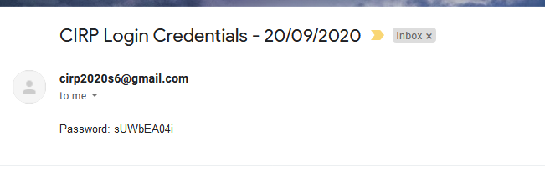
Application startup: all admins are created and initialized, they receive the randomly generated password by email.

Slide 42
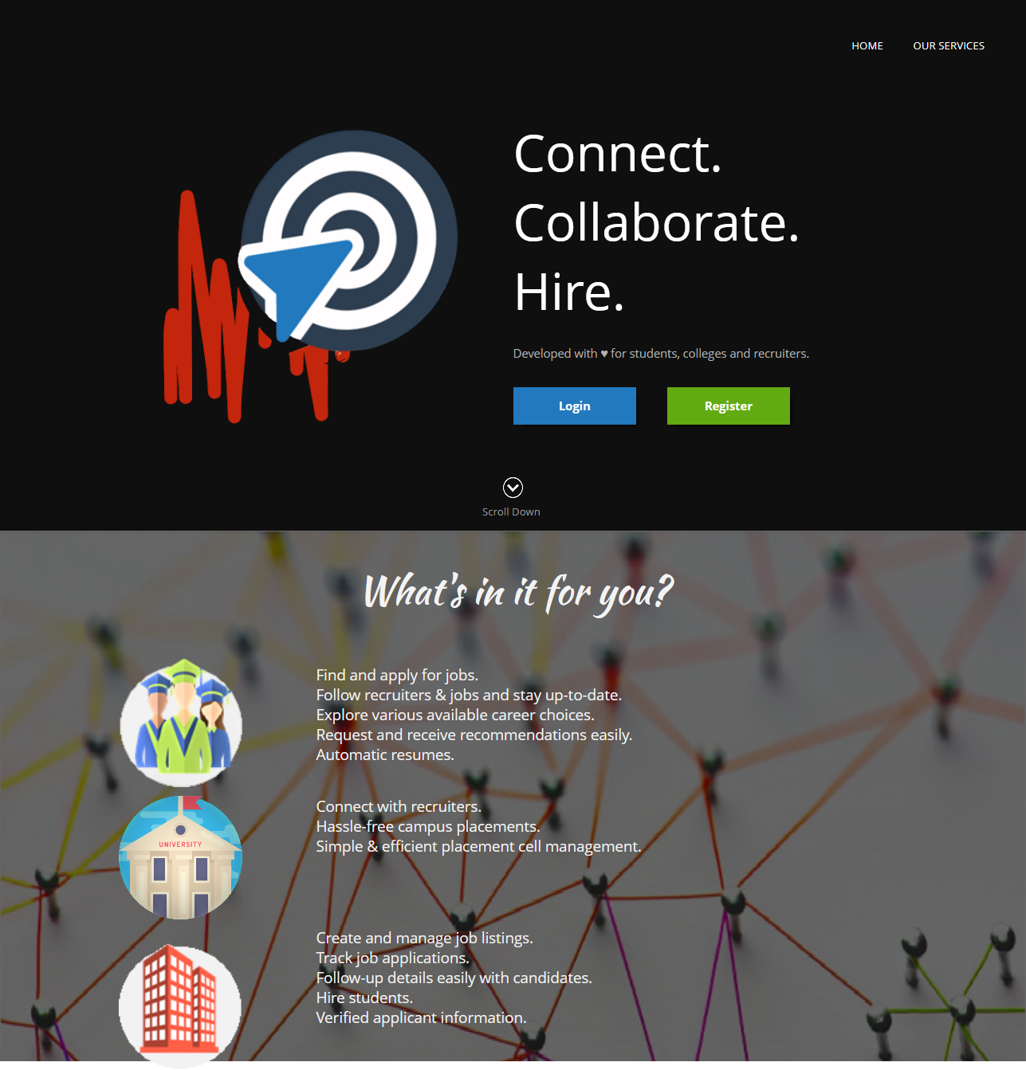
Full page screenshot of home page. Our Solutions in the navigation bar redirects to the anchor “What’s in it for you?”

Slide 43
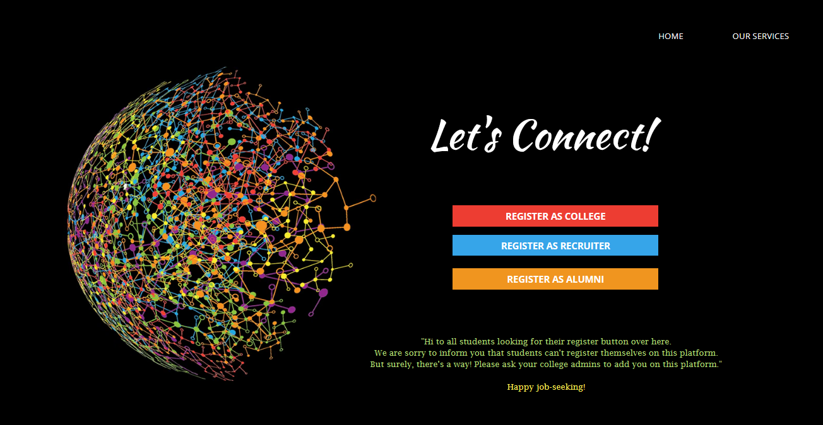
Register Page

Slide 44
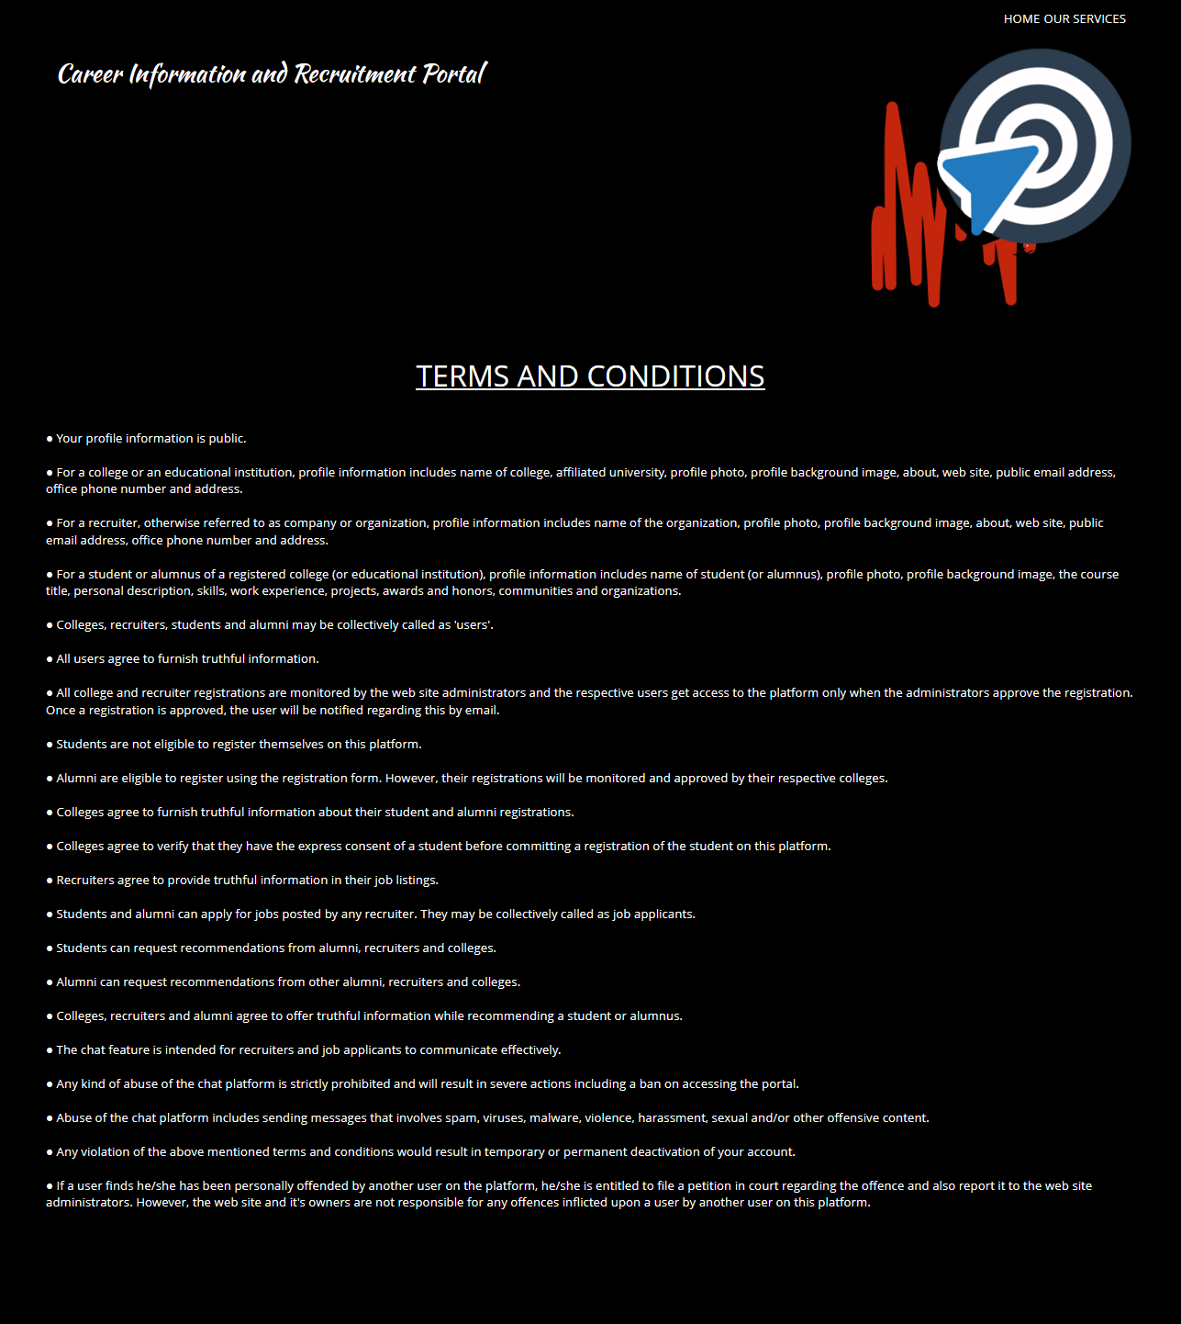
Terms and Conditions Page

Slide 45
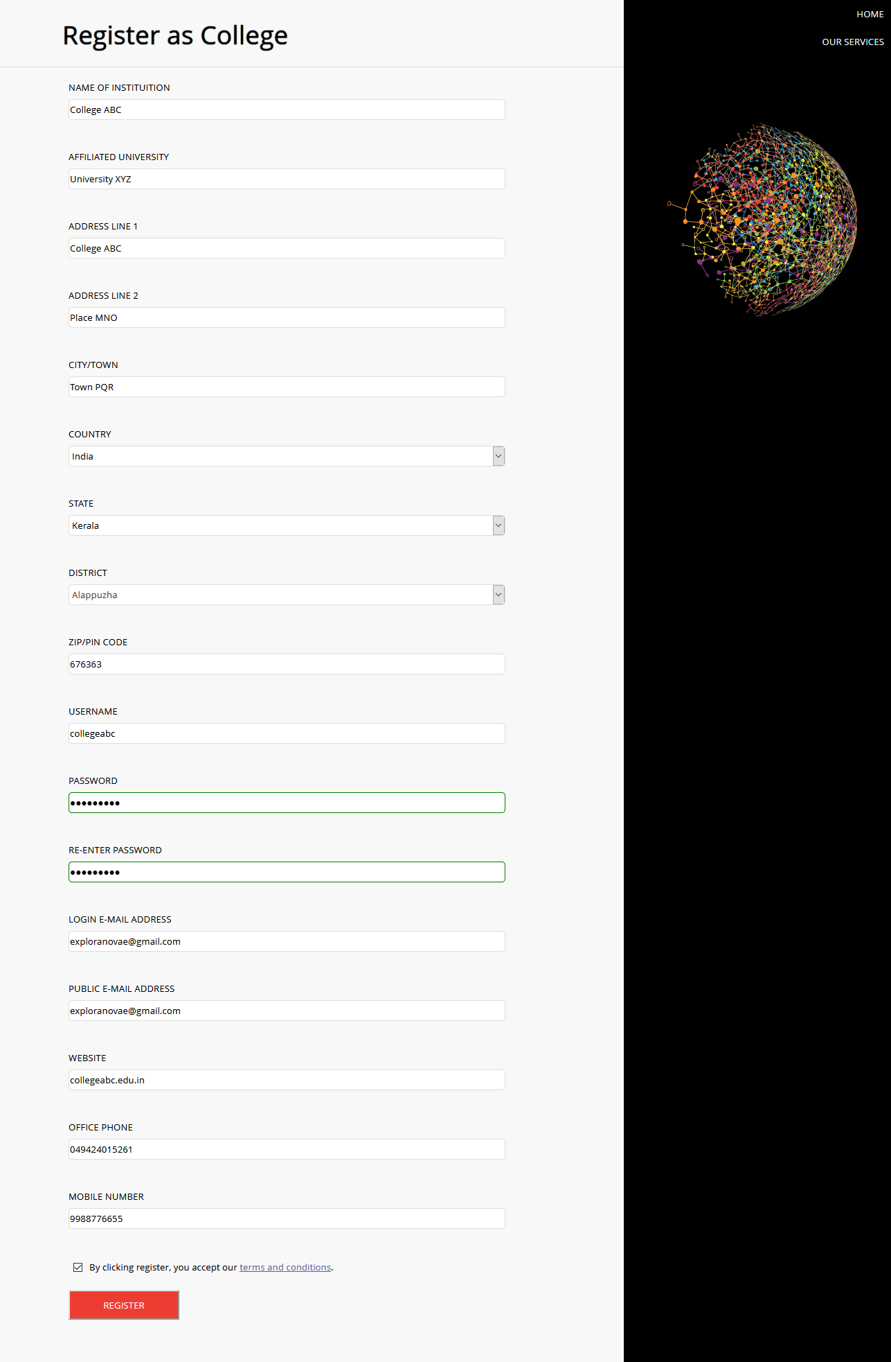
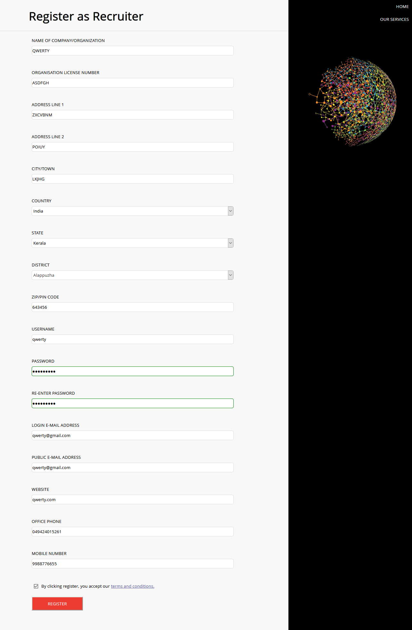
College Registration Page
Recruiter Registration Page

Slide 46
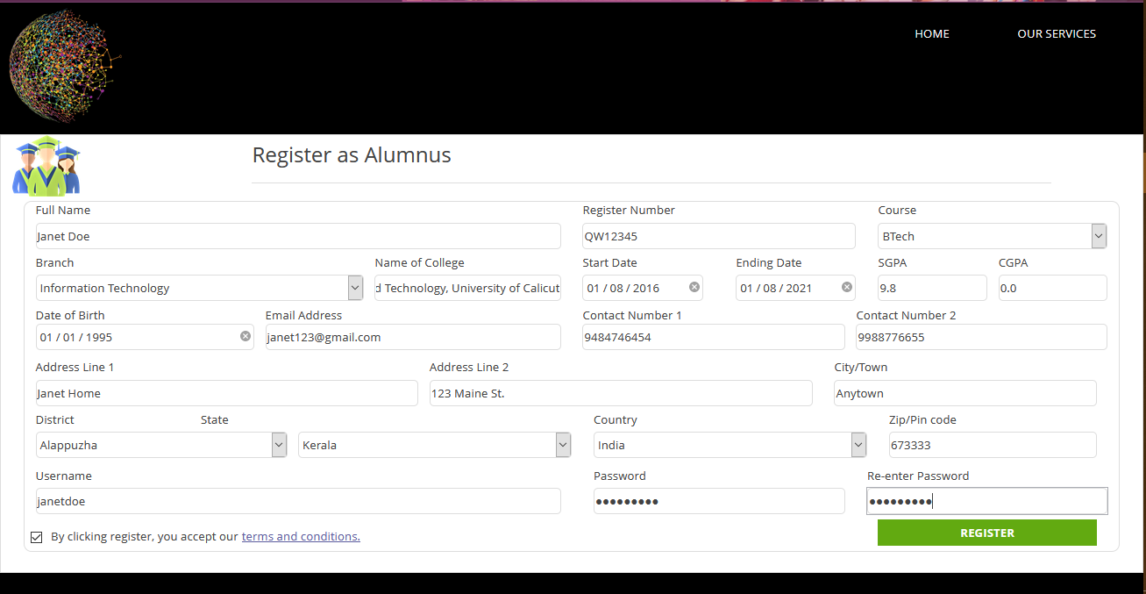
Alumnus Registration Page

Slide 47
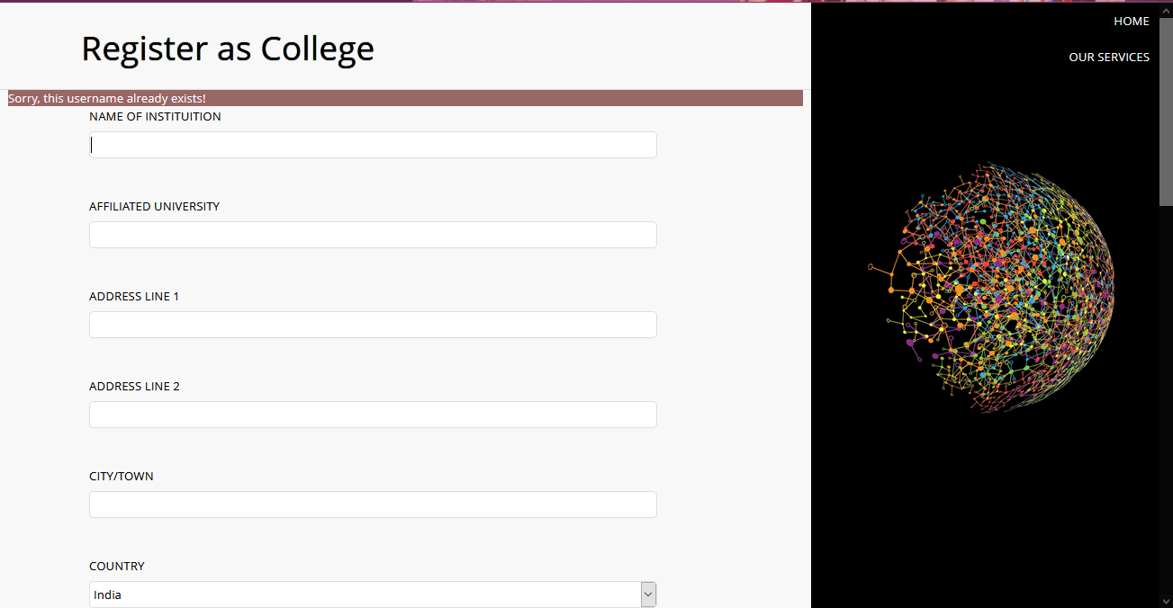
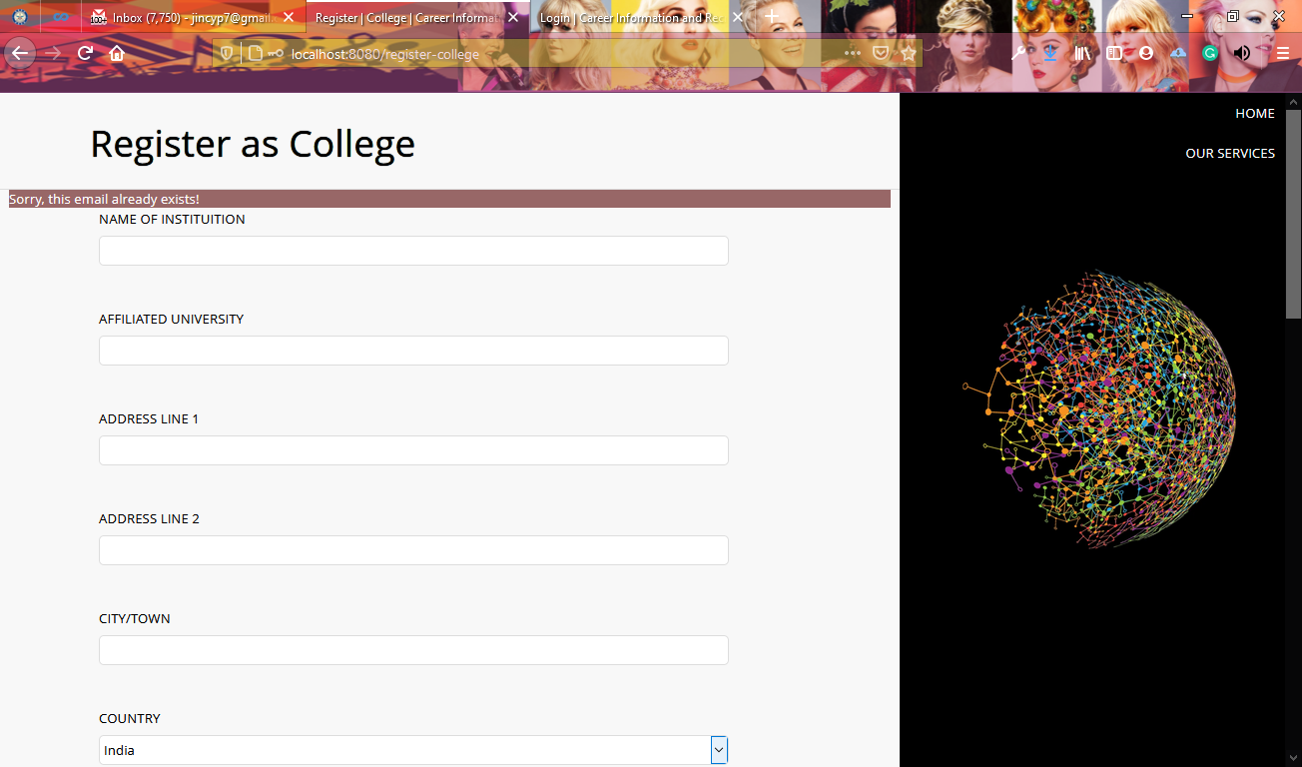
Registration exceptions/success notifications to user.
NB: This is similar in all registration pages and hence avoiding repetition.

Slide 48
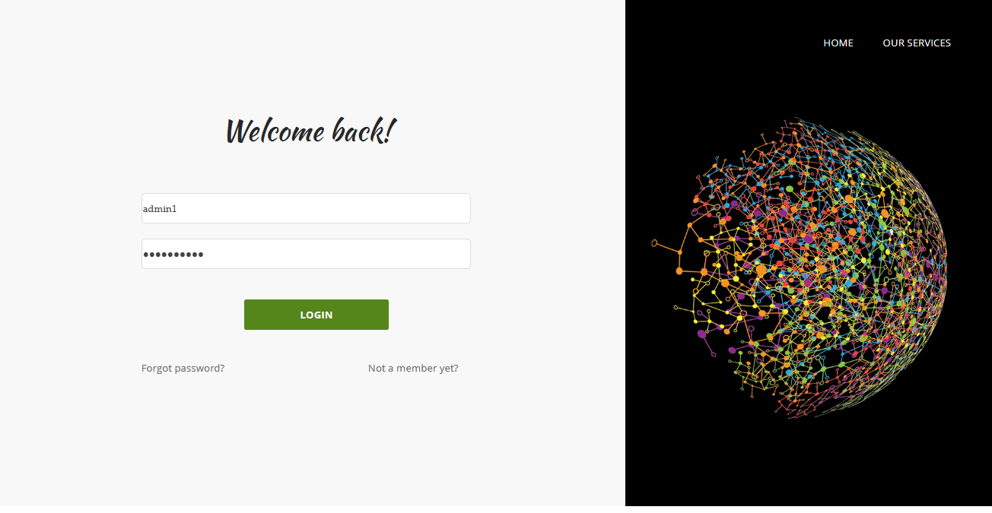
Login with username

Slide 49
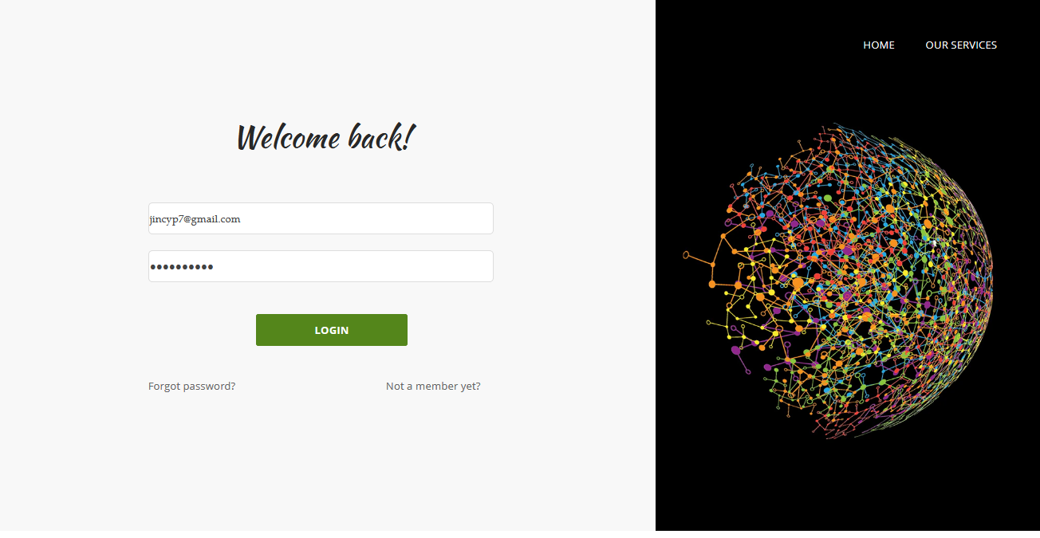
Login with email

Slide 50
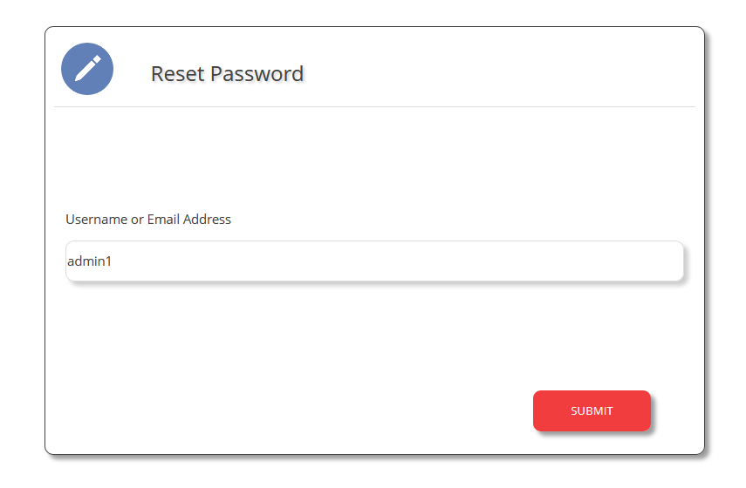
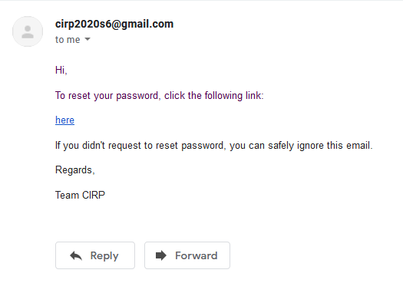
Forgot password from login page redirects here
Reset password link send to user’s email.

Slide 51
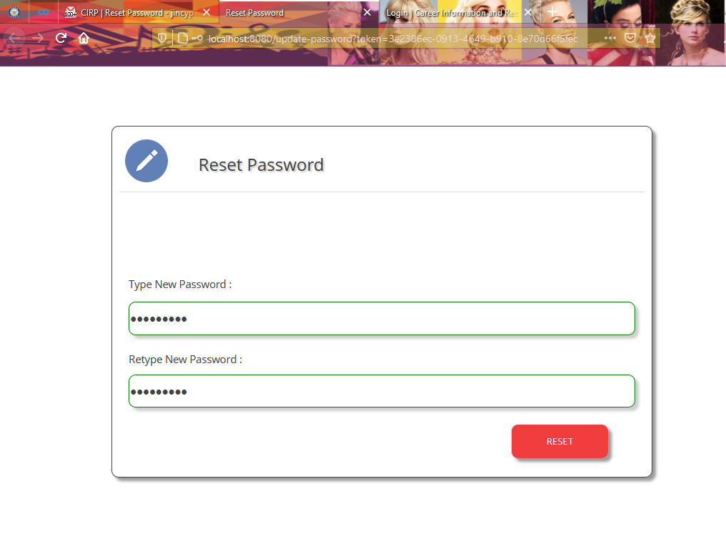
Form to reset password.
NB: Browser navigation bar is included in the screenshot to assert token based and user-specific password reset link.

Slide 52
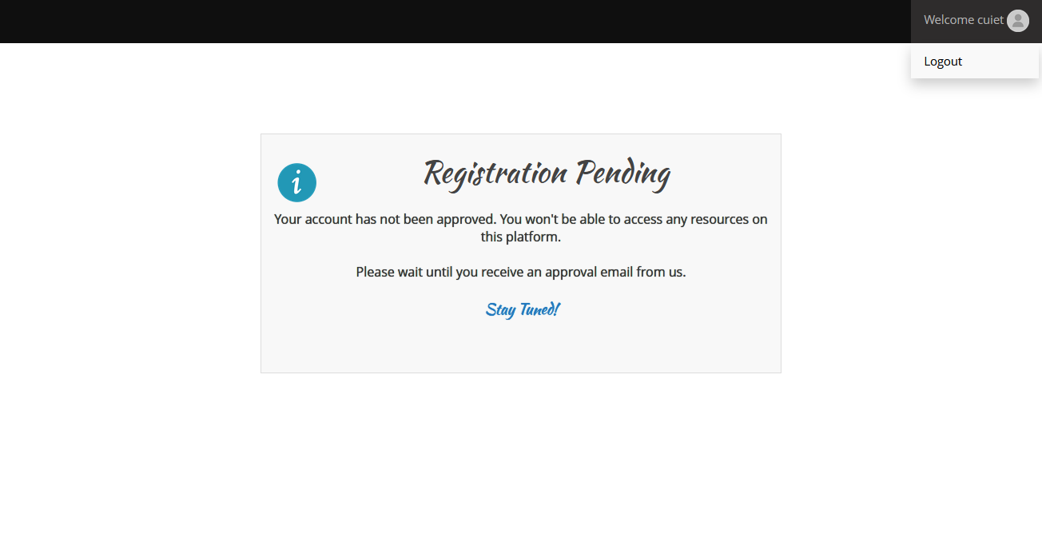
Logins of users whose registrations are not yet approved redirects to this Registration Pending page. As you can see from the above screenshot, such users cannot access any other pages.

Slide 53
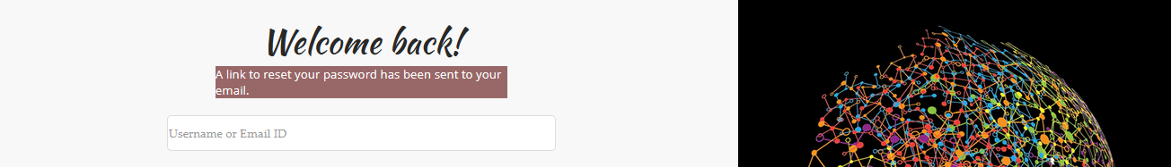

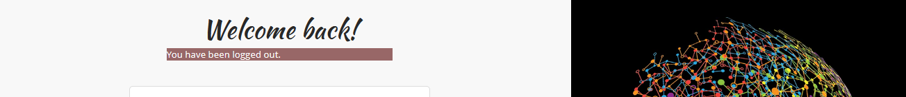
Notifications on login page regarding password reset and log out.

Slide 54
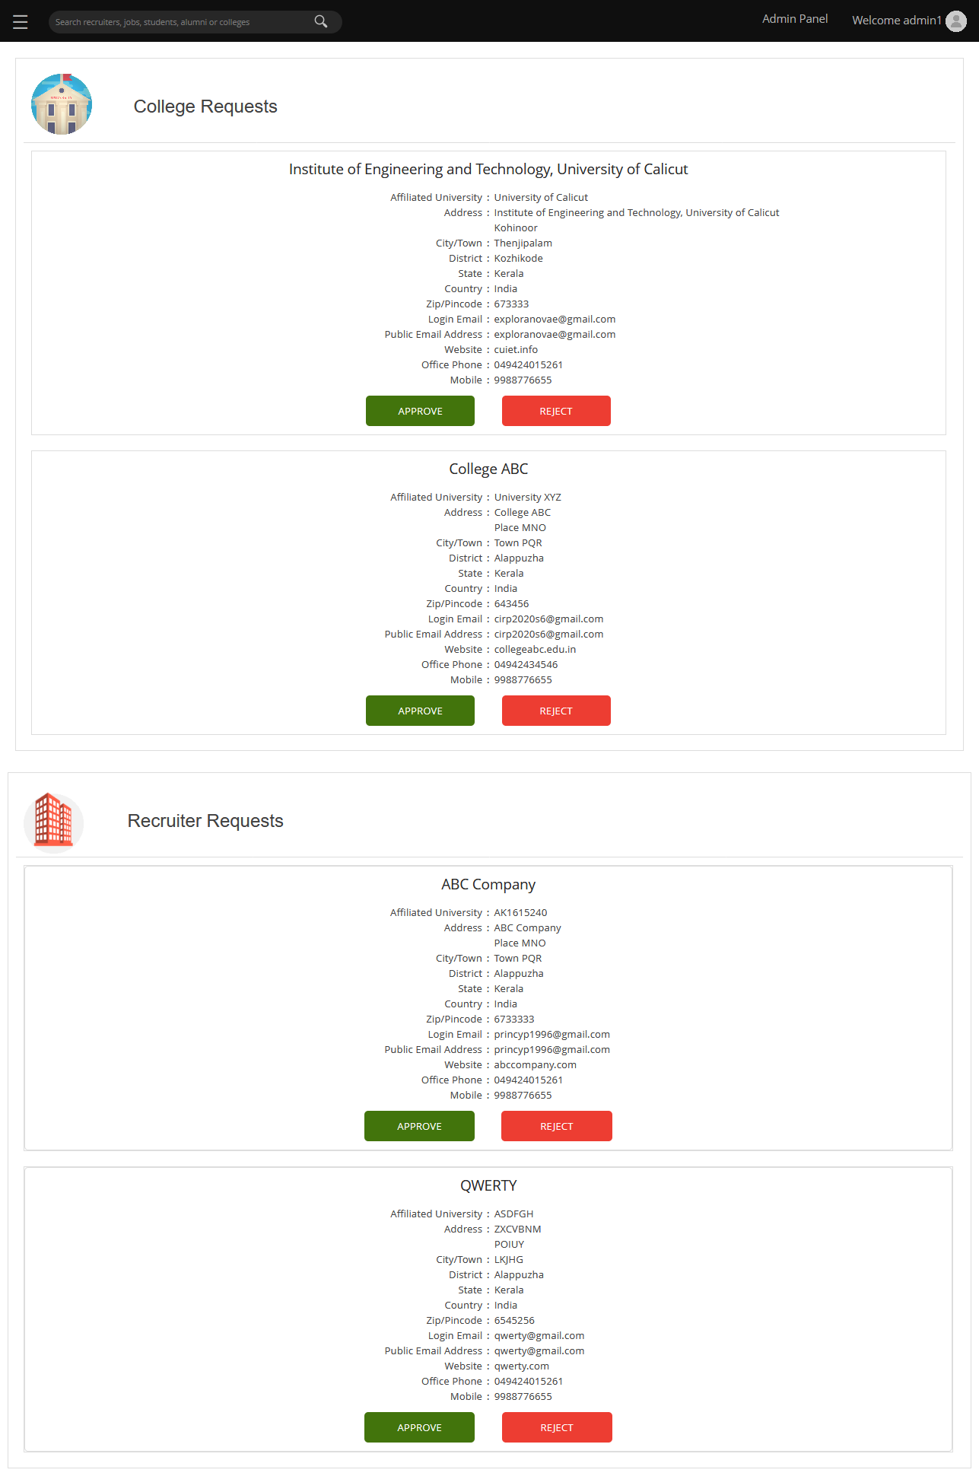
Admin Panel for website administrators with 2 pending college and recruiter registration requests each.
(The screenshot has been cropped and placed side-by-side for better legibility.)

Slide 55
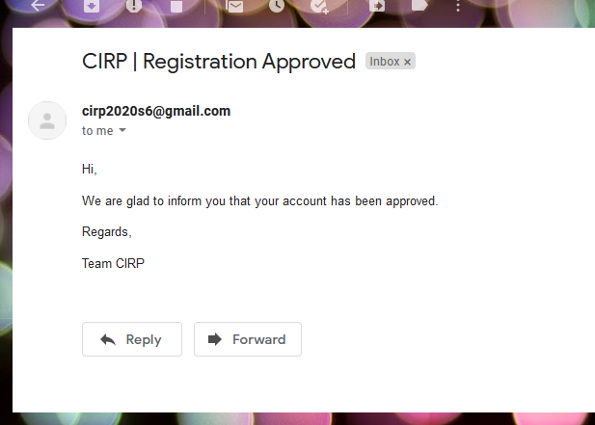
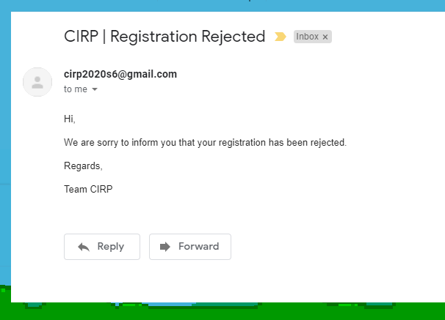
Users receive approved or rejected registration email when all admins (associated college, in case of alumnus) approve their request.

Slide 56
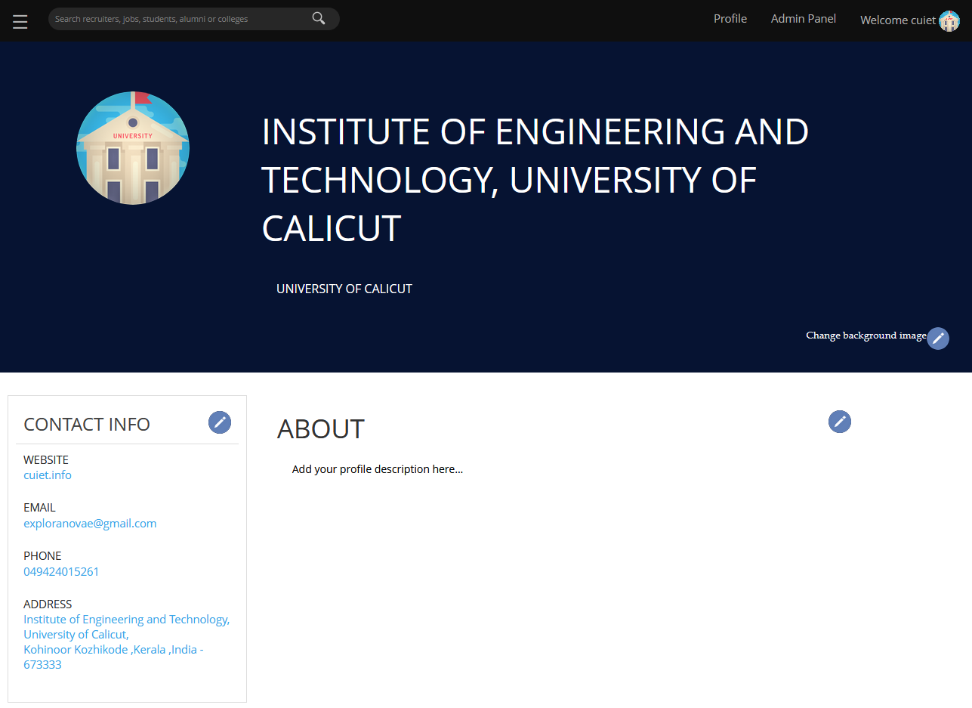
Home page (profile) for college – default – before user adds any customization.

Slide 57

Home page (profile) for college – after the user has added all possible customizations.

Slide 58

Side menu bar

Slide 59

College admin panel with one alumnus request pending

Slide 60

Add students (from college admin panel)

Slide 61

Home page (profile) for recruiter – after the user has added all possible customizations.

Slide 62

Manage jobs page before any jobs are added

Slide 63

Create Job

Slide 64

Manage jobs page after adding some jobs

Slide 65

Search result for ‘Kerala’ (without filtering). The results are automatically sorted according to relevance. Jobs are considered to have the highest precedence. Students and alumni follow and they are sorted according their skills listed in their profile.
(NB: the results are cropped and placed side-by-side for better legibility.)

Slide 66

View and Apply for a Job

Slide 67

Recruiters’ page to view all applications received. The applications are sorted according to the applicants’ skills that match the skills for the job and also according to time of applying (descending).

Slide 70

Error or Exception Handling (403, 404, etc.)

Slide 71
TESTING
UNIT TESTING
INTEGRATION TESTING
VALIDATION TESTS
JUnit tests where conducted for each of the modules and packages in the application.
Tests were repeated with various use cases and asserted that all functionalities were working as expected.
After all unit tests where successful, the packages where tested for integration and compatibility.
When necessary, individual packages and modules were reconfigured to adapt for better integration.
Validation tests were achieved with the combined application of data model constraints, controller annotations and UI restrictions.

Slide 72
SAMPLE TEST CASES
UNIT TESTING
INTEGRATION TESTING
Create Job
{
"_id":"5f677262f5dad49355aa7bb0",
“recruiter_id":“recruiter1",
“title”:”Software Developer”,
“desc”:”Sample test case – software developer job”,
“location”:”Place ABC”,
“duration”:”3 months”,
“stipend”: 35000,
“last_date": {
“$date": "2020-09-28T18:30:00.000Z“
}
}
Register College, Update Profile Info
{
"_id":"cuiet",
"affil_univ":"University of Calicut",
"contact": {
"website":"cuiet.info",
"landph":"049424015261",
"public_email":"exploranovae@gmail.com",
"address_line1":"Institute of Engineering and Technology, University of Calicut",
"address_line2":"",
"city_or_town":"Thenjipalam",
"district":"Kozhikode",
"state":"Kerala",
"country":"India",
"pincode": {
"$numberLong":"673333“
}
},
"approval_count":4,
"password":"$2a$10$C./AIEdRrnk03UJAKJ3U8ufm6LzNHeDrz8z4yD8zjLsNgZMf.ypxK",
"name":"Institute of Engineering and Technology, University of Calicut",
"mobile":"9988776655",
"email":"exploranovae@gmail.com",
"status":1,"role":"ROLE_COLLEGE","_class":"com.cirp.app.model.College",
"desc":"Institute of Engineering and Technology is a Self-Financing Engineering College run by the University of Calicut. The institute was established in the year 2001 with the aim to promote education and research in the field of engineering and technology and to groom the young men and women into high-quality technical personnel useful to the society”
}
VALIDATION TESTS
Sample screenshots for validation tests are included in the following slides

Slide 73

SAMPLE TEST SCREENSHOTS
Homepage displayed to a user when the account is pending approval from administrators

Slide 74

SAMPLE TEST SCREENSHOTS
Input validation in UI, the form cannot be submitted without filling all required fields.
Red border is used to indicate invalid input. Green border for password inputs indicate passwords are matching.

Slide 75
FUTURE PERSPECTIVES
Finding a job opportunity as per your choice and qualifications becomes much easier through career information and recruitment portal.
Recruiters will be able to find candidates with good skills based on their own recruitment criteria.
The application can potentially replace manually maintained system for campus recruitments.
Future development scopes for the application include job/candidate suggestions using AI, advanced application tracking, etc.

Slide 76
CONCLUSION
This project provided us practical knowledge about Java enterprise web application development using spring boot and spring security frameworks, and MongoDB platform.
The application offers simple and interactive forms, which helps users to access data through a secure gateway.
The developed system is efficient and commercially deployable.
Job aspirants, recruiters and colleges can take advantage of this web application as an excellent job board.

Slide 77
REFERENCES
[1] Rajib Mall, Fundamentals of Software Engineering, 2nd ed., IN: PHI, 2003
[2] Pankaj Jalote, A Concise Introduction to Software Engineering, 1st ed., UK: Springer, 2008. [E-book] Available: Springer e-book
[3] Barber L. (Mar 2006). e-Recruitment Developments. Institute for Employment Studies, Brighton. [Online] Available: https://www.employment-studies.co.uk/resource/erecruitment-developments
[4] Ranga Karanam, Creating a Web Application with Spring Boot, DZone, Jun. 02, 2017. Accessed on: Jul. 08, 2020. [Online] Available: https://dzone.com/articles/creating-a-web-application-with-spring-boot

Slide 78
THANK YOU!

